Slide 1
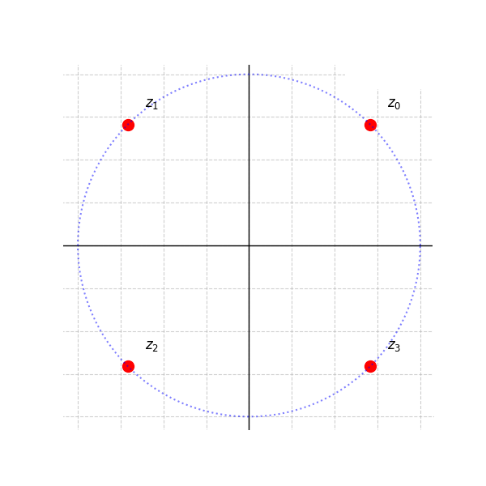










$$C_{R}$$
$$a_{2}$$
$$a_{1}$$
$$C_{a2}$$
$$C_{a1}$$
$$C_{1}$$
$$−R$$
$$R$$
$$a_{3}$$
$$a_{4}$$

